Slide 1


Cloud Excellence Presentation
Team 4 aka Team Gremlin
Members: Jeffrey Kuras, William Records, Ahmet Guc, Belsay Diaz-Valera
February 2022

Slide 2


TEAM 4 Project: Gremlins in the Machine
Our Official Project for the Booz Allen Cloud Excellence Program
www.webagesolutions.com|1.877.517.6540

Slide 3

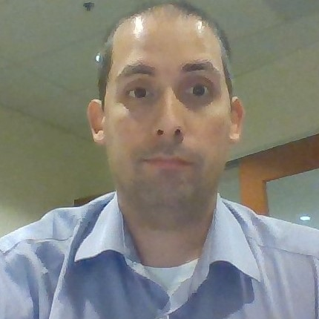


INTRODUCTIONS
JEFFREY KURAS Lead Technologist
WILLIAM RECORDS Associate
AHMET GUC Engineer
BELSAY DIAZ-VALERA Lead Technologist

Slide 4

Project
Introductions
Project Overview
Architecture/Design
Tools/Software Environment
Challenges/Issues/Problems
What we learned
Demo
Future Plans
Questions and answers
Scenario 1: Serverless static webpage hosted in S3.
Scenario 2: Auto-scaled EC2 webservers behind an Elastic Load Balancer, using the Gremlin Chaos Engineering platform to simulate stress/attacks on the system.
CI/CD pipelines used for all application deployment.
www.webagesolutions.com|1.877.517.6540

Slide 5
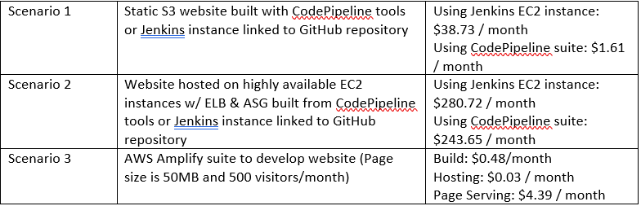
Initial Direction
S3 computations based on 2GB of needed storage
CodePipeline is $0 initially, then $1 per active pipeline per month
CodeDeploy computations based on 1 deploy/week to Lamda for 4 deployments/month
EC2 computations for 2 web servers based on:
$0.10/hr for Apache AMI deployed on Ubuntu 18.04
$0.046/hr for t2.medium EC2 instance (Apache recommended)
Uptime of 24 hours/day for 7 days/week for 30 days/month = 720 hours/month
50GB EBS volume = $5/month
Elastic IP for each server = $5.60 ($2.80 X 2)
No cost for ASG group, just for resources provisioned
Application Load Balancer for same uptime requirements = $16.20/month

Slide 6
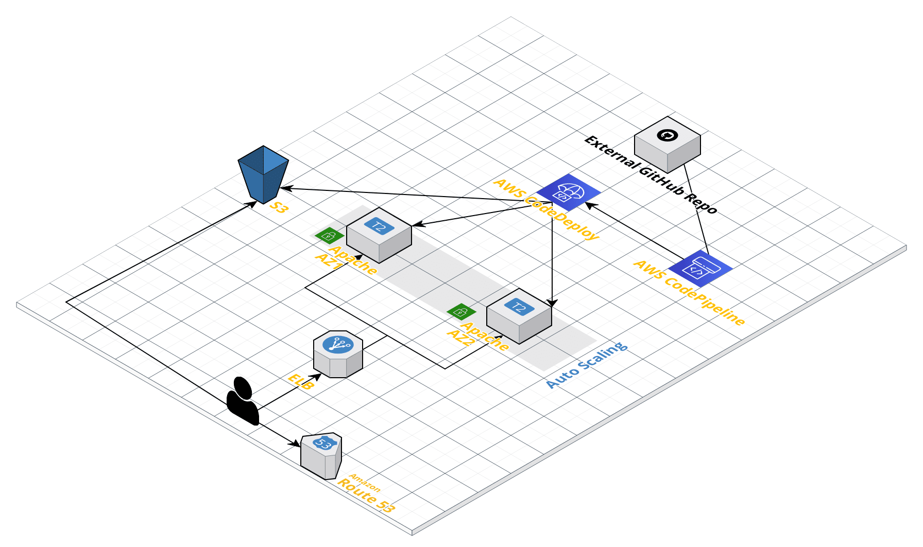
Architecture and Design

Slide 7
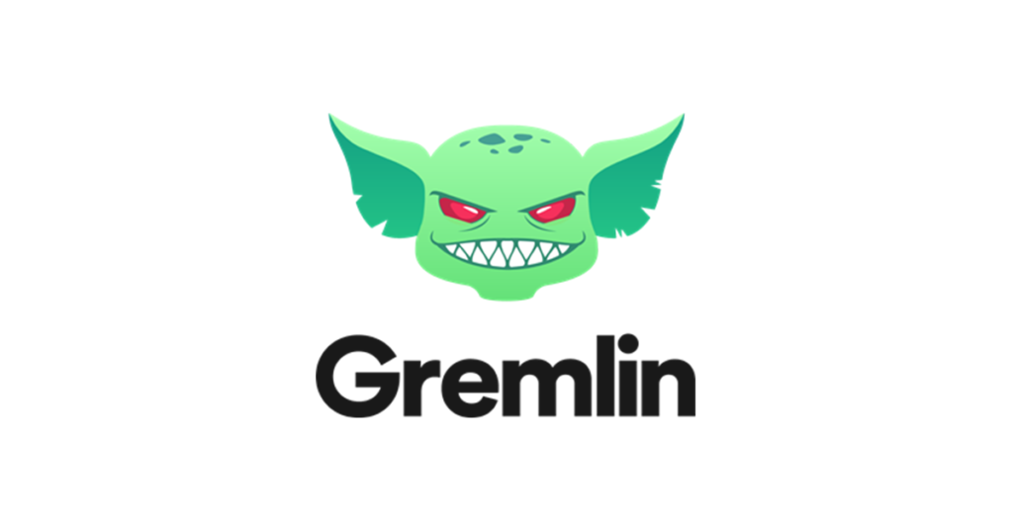






Technologies and Environment used
AWS Simple Storage Service (S3)
AWS CodePipeline
Git with Github Repository
AWS CodeDeploy
AWS Cloudformation
AWS Elastic Compute Cloud (EC2)
AWS AutoScaling
AWS Application Load Balancer (ALB)
AWS Cloudwatch
AWS Billing
AWS Identity Access Management (IAM)
AWS Virtual Private Cloud
AWS Launch Templates
AWS AMI MarketPlace
Gremlin
AWS Launch Template

Slide 8
Challenges and Issues
#1 CloudFormation Templates / Use of Designer with tutorial
#2 Auto-Scaling Group with Gremlin agent & scale-in protection
#3 Configuring proper tags between Code Deploy and Launch Template (to ensure code deployed correctly to right instances)
#4 Pushing two deployments at the same can create conflicts
#5 Permissions with the user data that installed dependencies on our EC2 instances
Lessons Learned
Utilize CloudFormation templates as starting point vs. building from scratch
Utilize scale-in protection with Auto-Scaling
Hands-on learning is the best learning tool

Slide 9
Demo – How does it work?
In a hypothetical scenario, the EC2 instance hosts a small business's website. The small business went viral after being featured on television. The objective is to create a solution to handle an influx of website traffic. The Auto Scaling Group operates the web servers while the Application Load Balancer loads the balance between the instances inside that Auto Scaling group. The Gremlin application simulates stress tests on the EC2 instances to confirm the Auto Scaling group works as expected.
- Create an Application Load Balancer
- Create a Launch Template
- Create an Auto Scaling Group
- Test Horizontal Scaling

Slide 10
Future Plans
Enhance the webpage using serverless AWS Services:
Use AWS Lambda, API Gateway, and SES to create an email page
Use AWS Lambda, API Gateway, and DynamoDB to create a blog page
Re-engineer the media pages to make use of S3 buckets
Build a Gremlin attack launch page into the website using API Gateway
Dockerize the entire website/Gremlin application and use ECS or EKS
Finish the Cloud Formation template to include the entire stack

Slide 11
Q & A - Ask us anything

Slide 12
Thank you!!!
MARCH 2021

